Slide 1
Deep Learning Foundations
Darshana Shah
Lecturer
Week 3

Slide 3
Recurrent Neural Networks (RNNs)
RNNs are derived from feedforward networks, used to process sequential or temporal data, such as sentences, audio or time series data
RNNs find applications in Natural Language Processing (NLP) problems, such as
Translating one language to another
Captioning images
Recognising speech
Processing natural language
Real-life use cases include voice assistants like Alexa, Siri and Google Translate

Slide 4
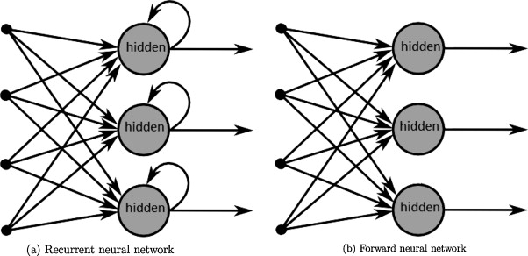
RNN vs Feedforward Network

Slide 5
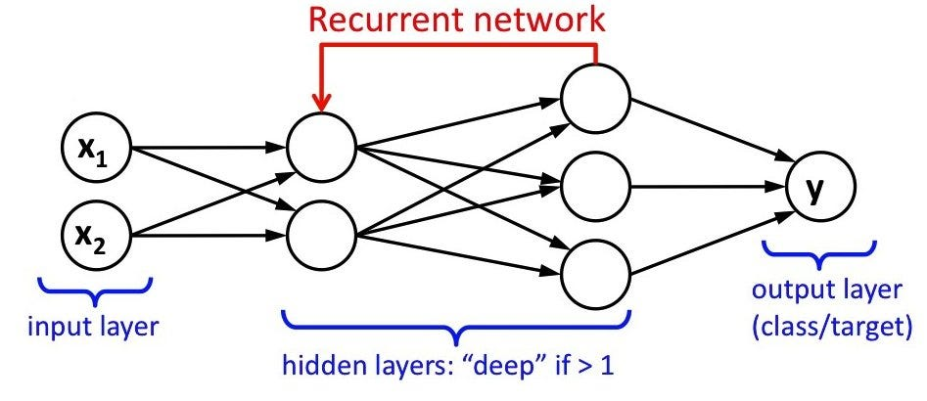
RNNs

Slide 6

What is RNN?
Imagine you’re reading a book
When you are reading a sentence, you keep in mind what you have read so far to understand the full context of the sentence, right?
This is basically how a RNN works - it has a form of memory!

Slide 7
RNN
RNNs were the first kind of neural network to have an internal memory, and are therefore incredible learners
Internal memory allows RNNs to use information from previous inputs to influence future behaviour
Differences between RNNs and feedforward networks
RNNs use loops whereas feedforward networks do not
RNNs share parameters over each layer of the network, while feedforward networks have different weight parameters for each node

Slide 8
RNN
Input and Output: In an RNN, we give it an input (like a word from a sentence), and it gives us an output (like the next word prediction).
Memory: But it also maintains a hidden state, or its "memory", from the previous inputs
Hidden State: This hidden state is updated every time we give the RNN a new input. So, if we're giving it words one-by-one from a sentence, it's updating its memory each time with the new word
Recurrent: The term "recurrent" means the output at a certain step becomes part of the input for the next step. This is what allows the RNN to carry information through a sequence and not treat each input in isolation
Training: During training, we adjust the internal parameters of the RNN based on the error of its predictions, using a method called backpropagation through time (BPTT). This process gradually helps the RNN to learn the correct weights and biases, so it can predict more accurately

Slide 9
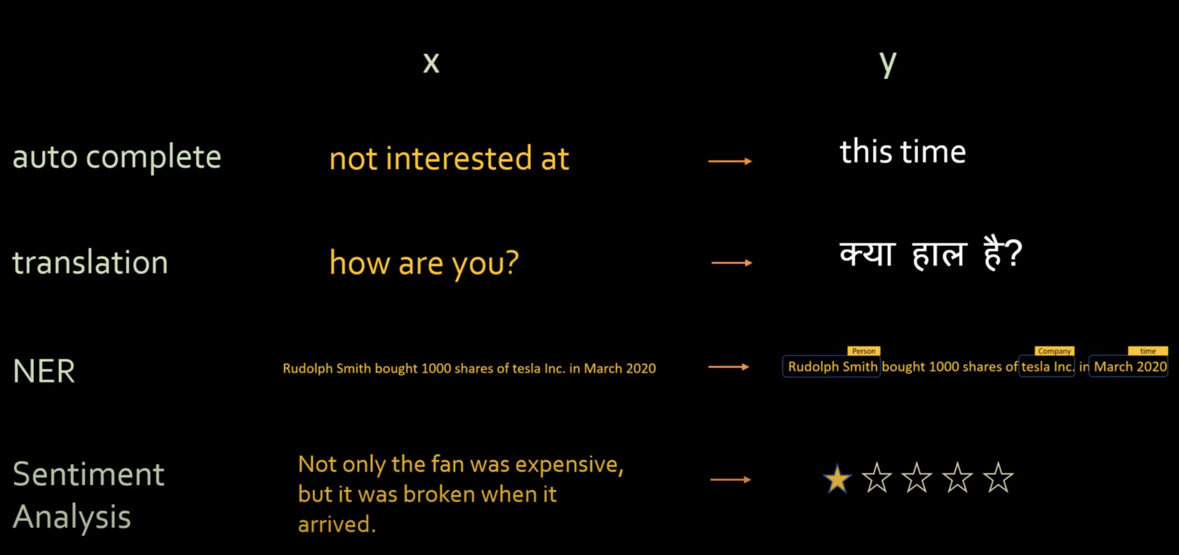
Use Cases

Slide 10
Types of RNNs
Sequence to Sequence
Price Forecasting
Sequence to Vector
Scam or not
Vector to Sequence
Image Captioning
Encoder-Decoder
Translation

Slide 11
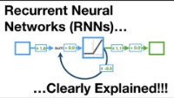
Understanding RNNs, Vanishing & Exploding Gradient Problems

Slide 12
Challenges
RNNs suffer from two problems
Vanishing gradients
Exploding gradients

Slide 13
Vanishing & Exploding Gradient Problems
When running an RNN, the weights update with each iteration to make the predictions of the model more accurate
However, sometimes when the weights are being updated, they just keep getting smaller and smaller, until they are no longer updated, and the model stops learning before it starts making accurate prediction
This problem is called the vanishing gradient problem
This problem occurs because, in each layer, the weight ends up being multiplied by itself
If the weight is, for instance, 0.6 in one layer, that means that for the next layer it will be 0.36, which is significantly smaller
For the layer after that it will be 0.1296, which is even smaller
The more layers you have, the smaller and smaller the weights become, and the less the model learns
It is worth noting that there is an equivalent problem with weights that are too large, called exploding gradients, the model will become unstable in this situation.

Slide 14
Solution 1: Activation Function
One solution to the vanishing gradient problem is to use an activation function such as the rectified linear unit function (ReLU function)
The ReLU activation function is especially useful because it returns the input if the input was a positive value, but if the input was negative, it simply returns a zero
Because the ReLU activation function sets negative inputs to 0, it effectively "turns off" the neurons that are not contributing to the output

Slide 15
Solution 2: Weight Initialisation
One of the reasons that vanishing gradients occur is because the weights are initialised randomly
One of the ways that you can ensure that the weights stay close to one is by using initialisation techniques
These techniques, instead of taking random samples, sample weights from within certain parameters regarding the mean and standard deviation
By adjusting these factors appropriately, the range of the weights is restricted which makes it less likely that they will become too small or too large

Slide 16
Solution 3: Gradient Clipping
The last method for dealing with vanishing gradients that we will discuss here is gradient clipping, which is another straightforward technique
Gradient clipping simply means setting boundaries for what the expected gradient is likely to be
If the gradient that is produced falls outside those boundaries, then it is set either to the maximum upper limit (if it was too high) or the minimum lower limit (if it was too low)
In practice, the code that sets the bound for clipping a gradient will look something like this:
gradients = [(tf.clip_by_value(grad, clip_value_min=-1.0, clip_value_max=1.0))
for grad in gradients]

Slide 17
Solution 4: Long Short-Term Memory
There is yet another solution to the vanishing gradient problem which is also an integral part of RNNs and their memory function
For example, if a RNN comes across a long sentence, it quickly forgets the context which affects the network's performance (because it cannot remember what is at the start of the sentence)
LSTM allows RNNs to perform better by analysing the information in text or time series data and extending the network's memory
This is essential for the network to learn from its past experiences and make better predictions
It also acts as a foundational aspect of the layers in RNNs, since it defines the weights of the data being used

Slide 18
What is LSTM?
A type of RNN to overcome vanishing gradient problem
Components of a LSTM
Cell State
Gates
Forget Gate
Input Gate
Output Gate

Slide 19

What is LSTM?

Slide 20
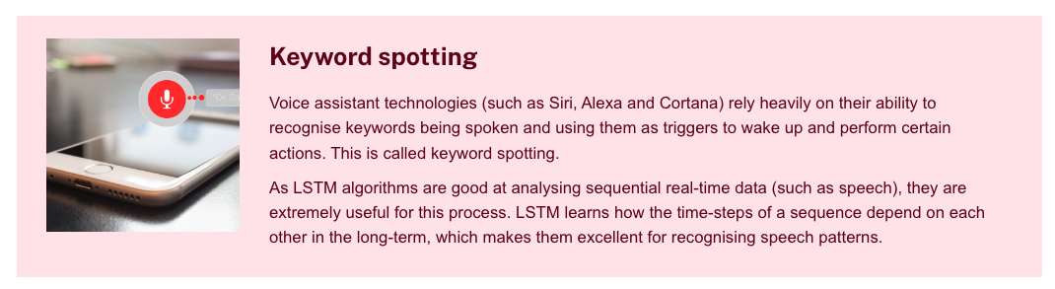
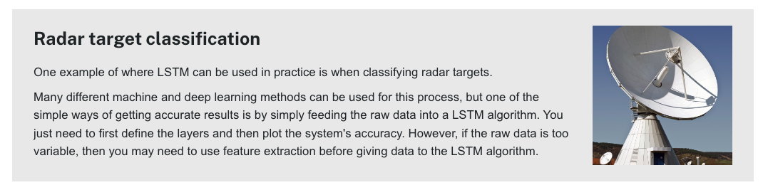
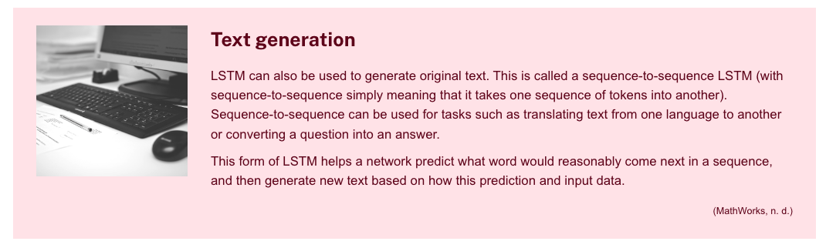
Applications of LSTM
Due to their enhanced memory, LSTM algorithms are often used as they perform better than basic RNN when needing to hold information for a longer period of time

Slide 21

Week 5
Boltzmann Machines
Restricted Boltzmann Machines
Deep Belief Networks
Applications

